Slide 1

April 2026

Slide 2
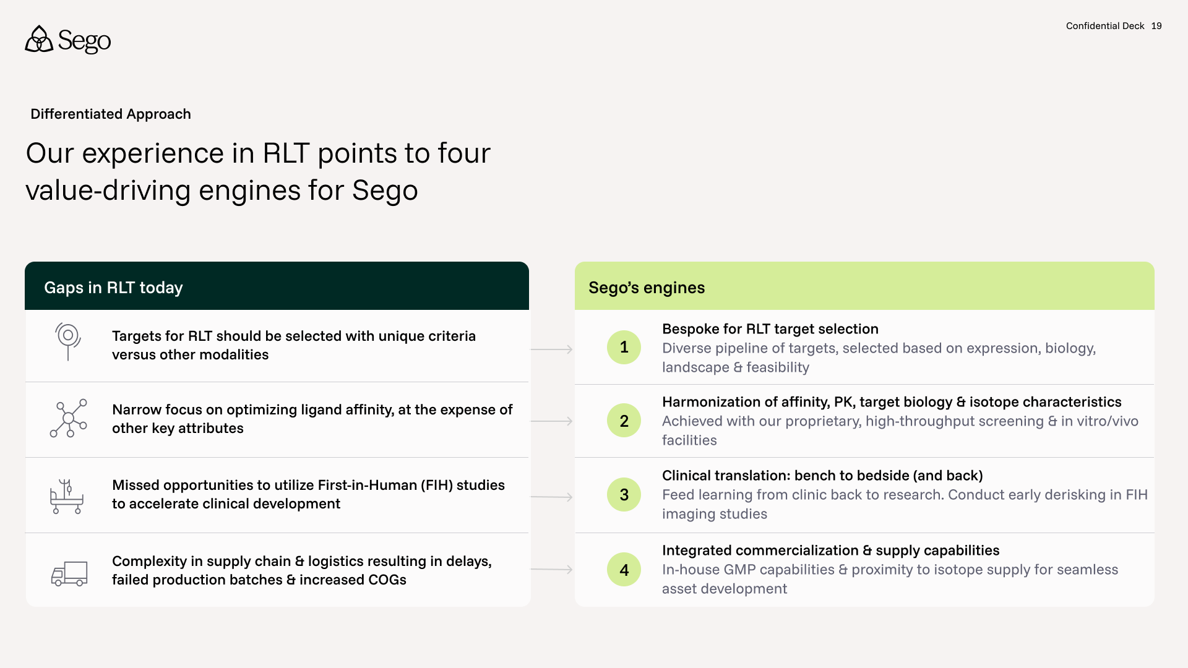

Slide 3
Sego’s bespoke approach to RLT target selection
Confidential 3

Slide 4
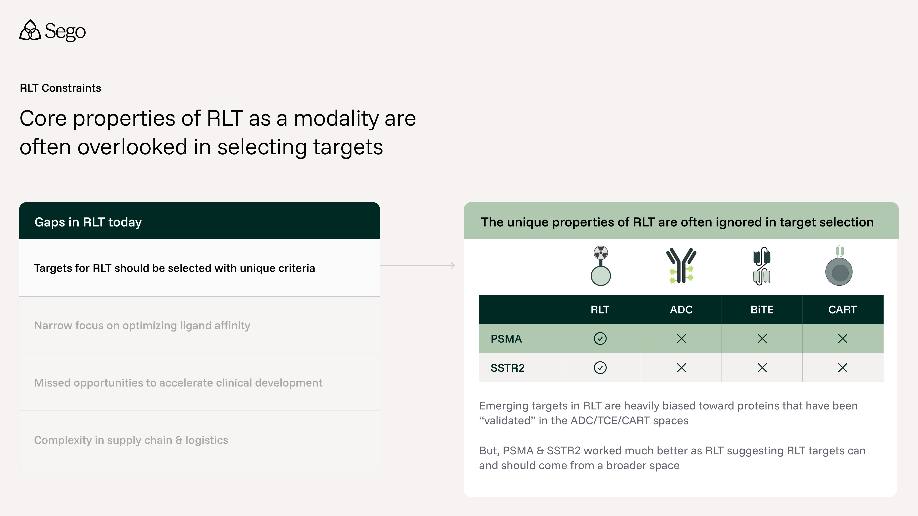
Confidential 4

Slide 5
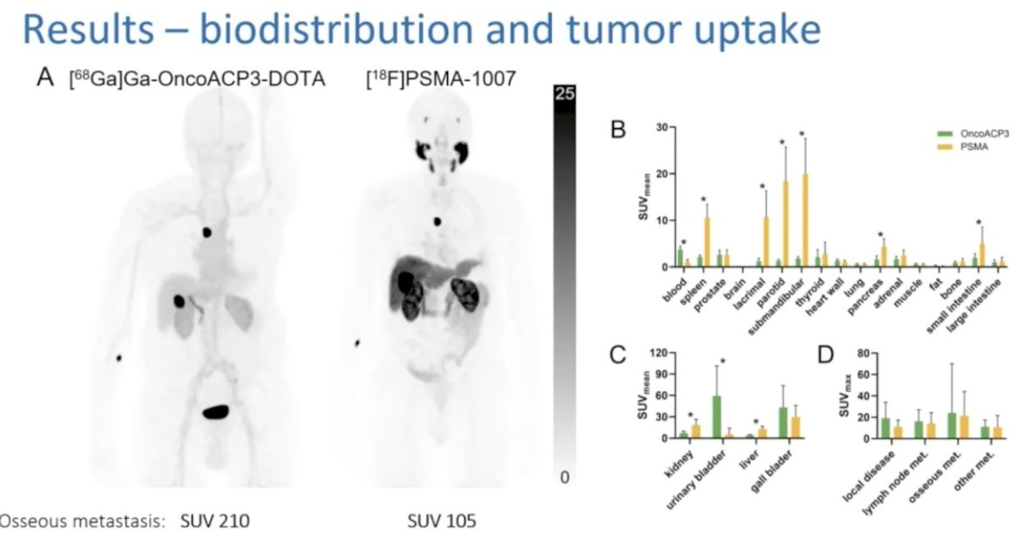
Developing successful RLT is balancing tumor absorbed dose vs. organ at risk absorbed dose by two methods: target selection
Candidate Selection
ACP3
PSMA
Tumor
absorbed dose
Drive down by:
Target selection: Minimizing target expression or accessibility in healthy tissues
Drive up by:
Target selection: Maximizing target expression in tumor
Organ at risk
absorbed dose
Ratio Tumor:Organ at Risk
Clean tumor uptake
Healthy organ uptake
Sources: Backhaus SNMMI Annual Meeting 2025

Slide 6
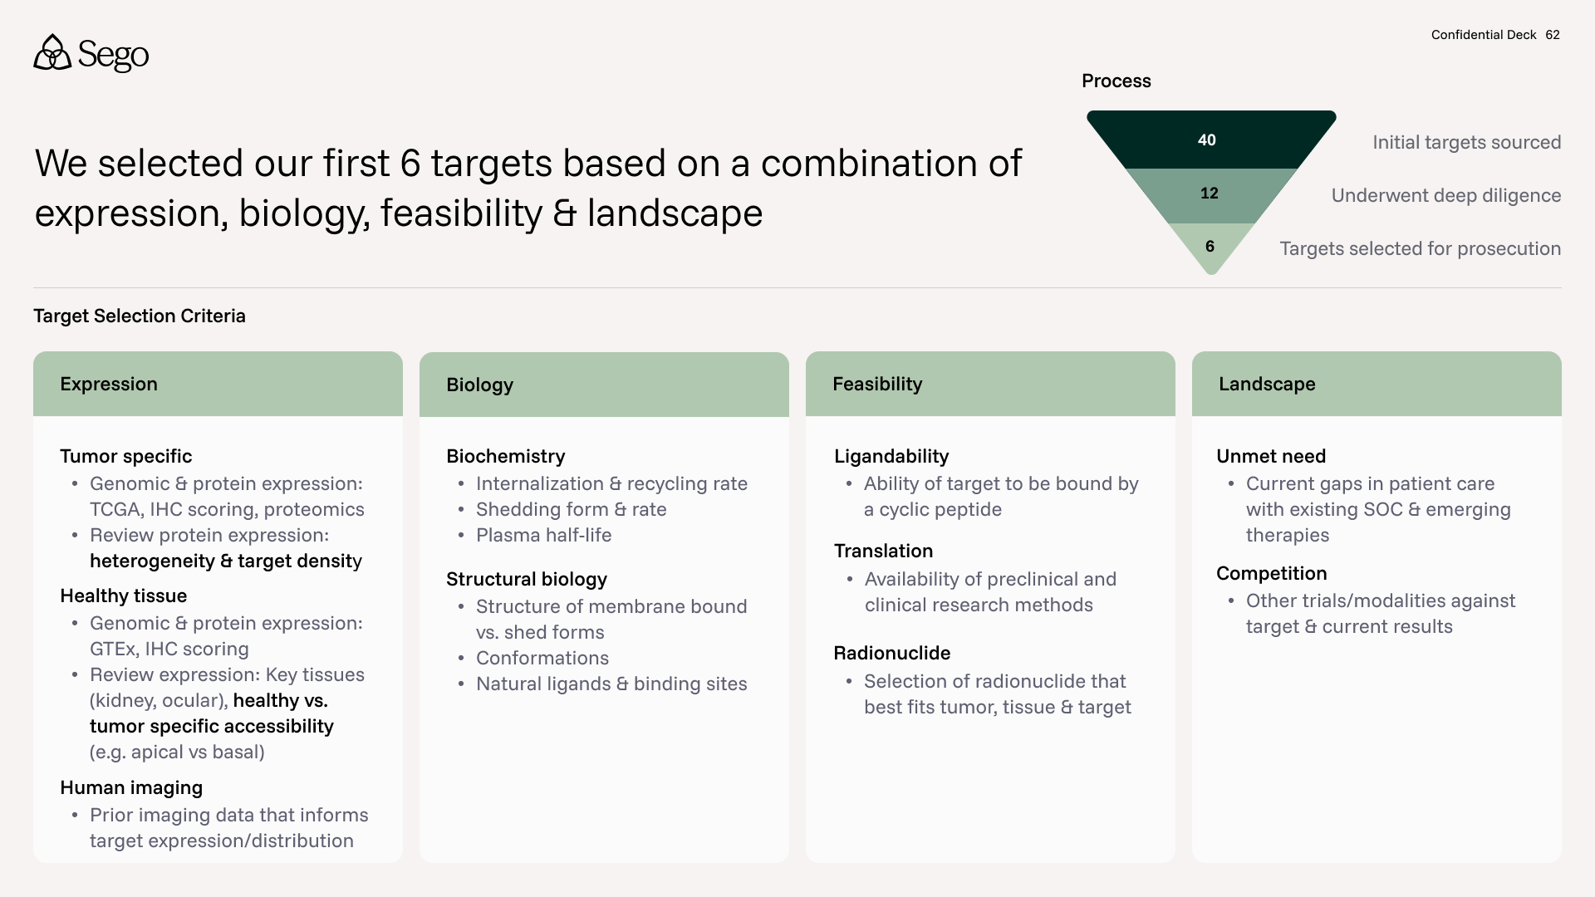

Slide 7
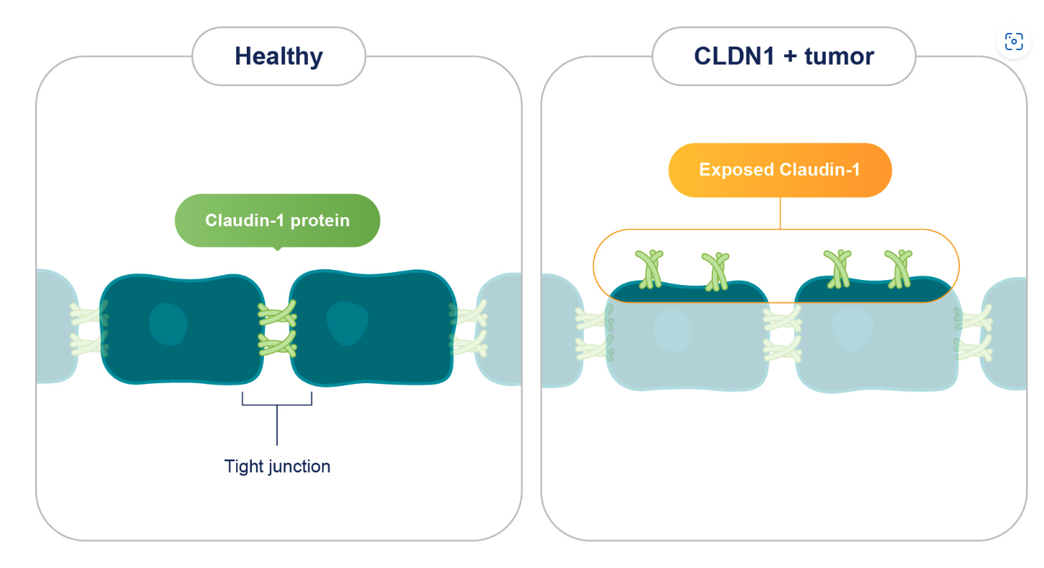
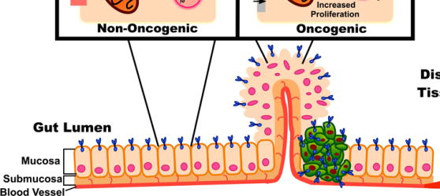
Looking beyond pure tumor vs. healthy expression: Harnessing tumor-specific epitopes which become accessible through loss of cell polarization & overexpression
Example 1: Apical localization due to healthy cell polarization is lost due to malignant transformation
Example 2: Tight junction localization due to healthy cell polarization is lost due to malignant transformation
Inside the colon
Apical target expression in normal epithelium
=> inaccessible
Target overexpression on the entire tumor cell membrane
=> accessible
Target fully “occupied” in tight junctions
=> inaccessible
Target overexpressed & present outside junctions
=> accessible
Bloodstream
Adapted from Aka Exp Rev Clin Pharmacol 2017, Image – Alentis
Confidential 7

Slide 8
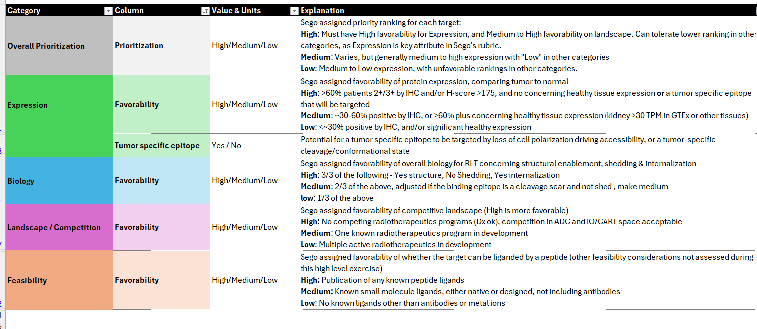
Target selection criteria were developed into a standardized rubric to evaluate 40+ targets at a high level
Confidential 8

Slide 9
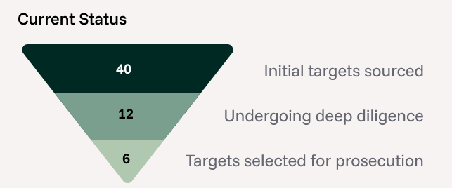
40 targets spanning enzyme, functional & structural classes were evaluated;
8 targets emerged as high priority
Category | Count | Targets
Receptor Tyrosine Kinases (RTKs) | 7 | FGFR2b, EGFR (cryptic), HER2, HER3, EphA2, RET, MET
Junction / Adhesion Proteins | 10 | CLDN1, CLDN18.2, Nectin-4, CDH3, CLDN4, EPCAM, TROP2, CDH6, CLDN6, UPK2
Ig or Ig-like Superfamily | 5 | CEACAM5, B7-H3, PTK7, DLL3, LRRC15
Non-RTK Enzymes | 6 | ACP3, KLK2, CA9, ENPP3, STEAP1, STEAP2
Mucins | 3 | MUC13, MUC16 (ecto), MUC1-C
GPI-Anchored Proteins | 4 | ALPPL2, GPC2, FRα (FOLR1), MSLN
Others (Singletons) | 5 | GPRC5A, LIV1 (SLC39A6), Fibronectin ED-B, GCC (GUCY2C), Integrin αvβ6
Total | 40
Priority | Count
High | 8
Medium | 12
Low | 20
Total | 40
12 (8 high + 4 mediums) were diligenced further,
6 have been selected as potential programs
Confidential 9

Slide 10
Our first 6 targets go beyond typical tumor vs. healthy expression selection considerations
Target Selection
 |  | CLDN1 Multi/Lung | MUC1-C Multi/Lung | CEACAM5 CRC | GCC CRC | ACP3 Prostate | KLK2 Prostate
Expression | No healthy tissue expression |  |  |  |  | ✓ | ✓
 | Tumor-specific accessibility | ✓ | ✓ | ✓ | ✓
Biology | Favorable internalization, shedding characteristics | ✓✓ | ✓✓ | ✓ | ✓✓ | ✓ | ✓
Feasibility | Ligandability | ✓ | ✓ | ✓ | ✓ | ✓ | ✓
Landscape | No competing RLT programs | ✓ | ✓ | ✓ | ✓
Adapted from Aka Exp Rev Clin Pharmacol 2017, Image – Alentis

